Slide 1
*When it says “raw” is just the raw data from FB with no adjustments (but we are not counting all the flows with low counts because those rows of the dataset are not reported to preserve user privacy)
*When it says “estimated” it means: we impute data for missing baseline values based on SIM, then we use that complete baseline to estimate missing values in the day-to-day movement data. We have used FB population counts at origin and destination, as well as distance between O and D as exogenous variables for the SIM.
*When it says “adjusted”, it means that on top of this imputation, we have also corrected the counts over time to keep numbers on the same scale, correcting for a possible loss in FB users.

Slide 2
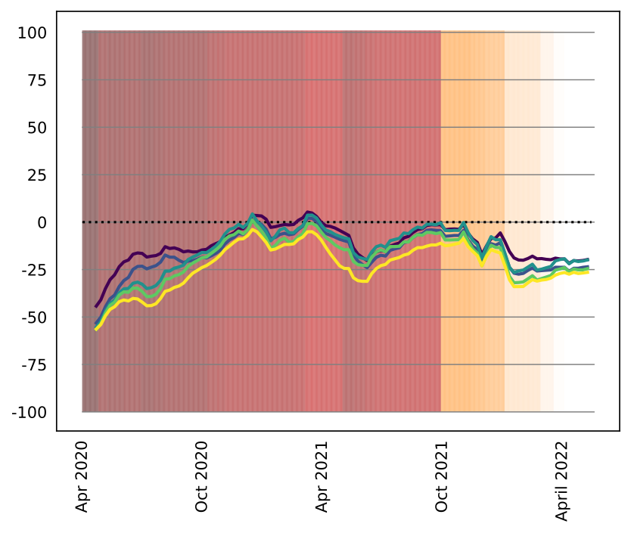
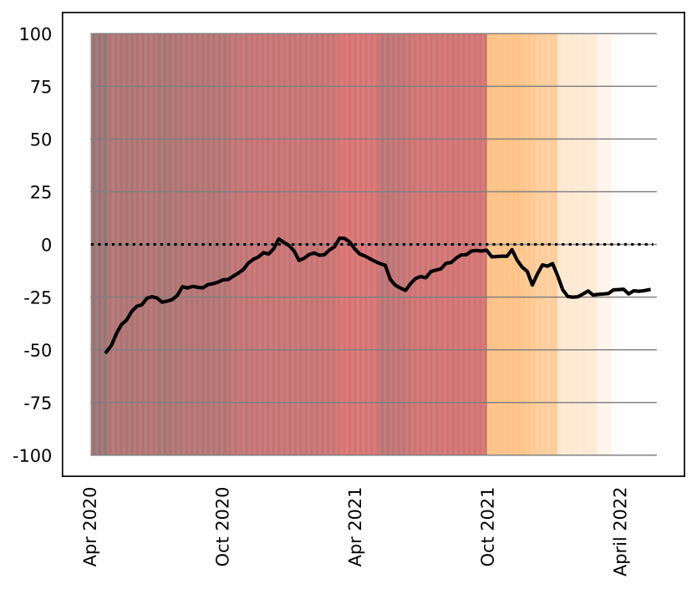

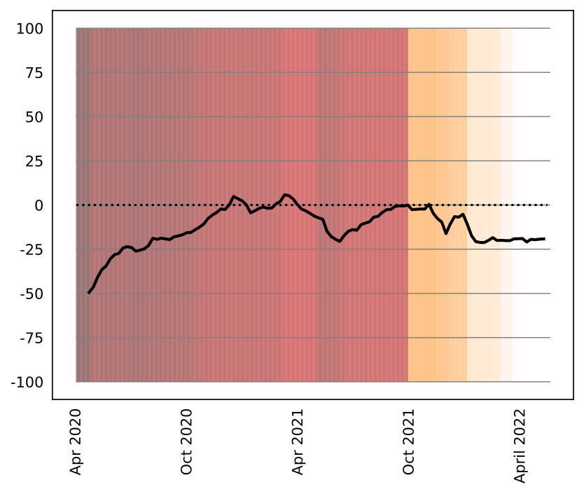
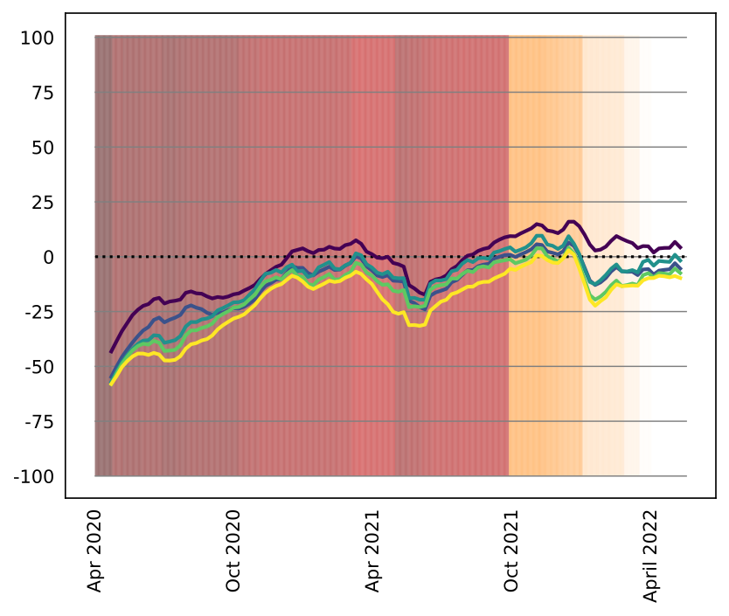
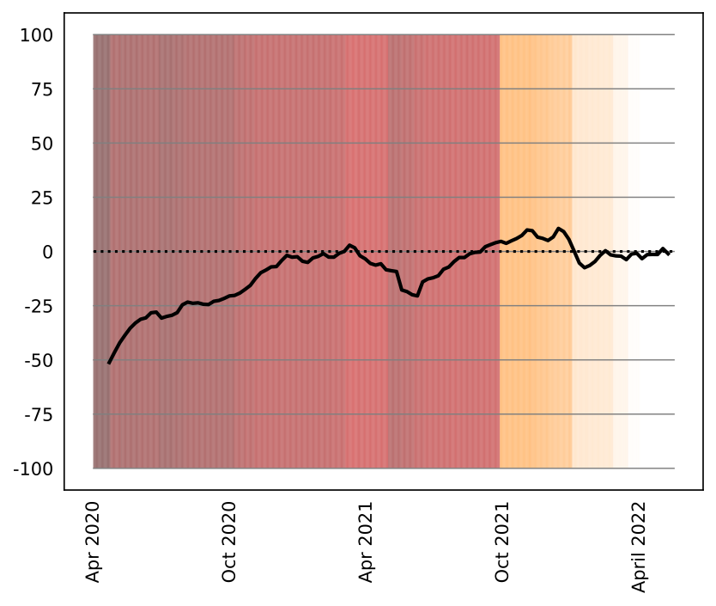
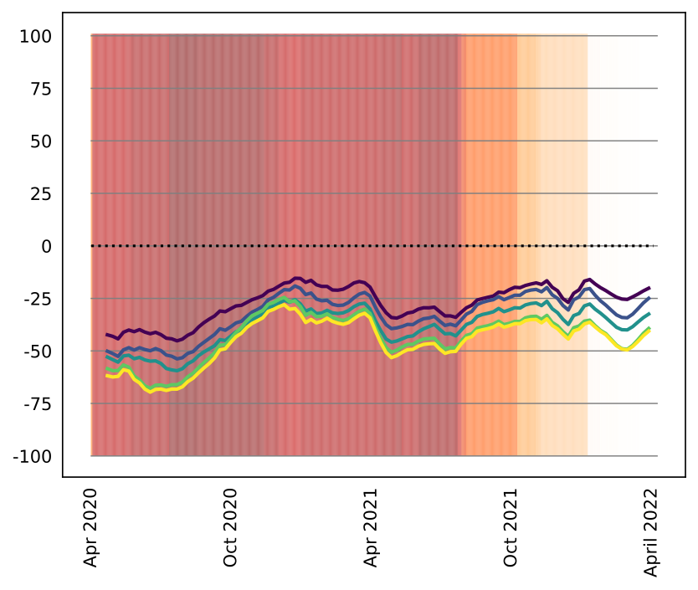
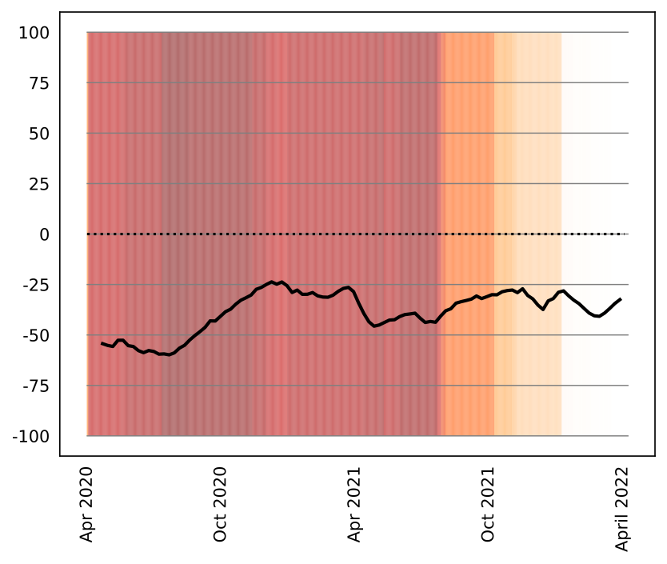


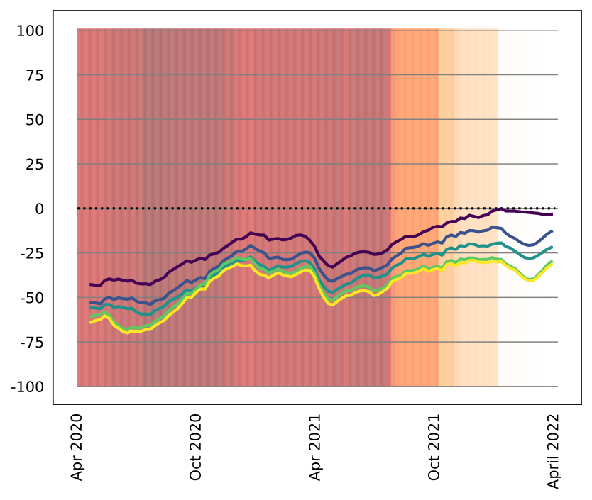
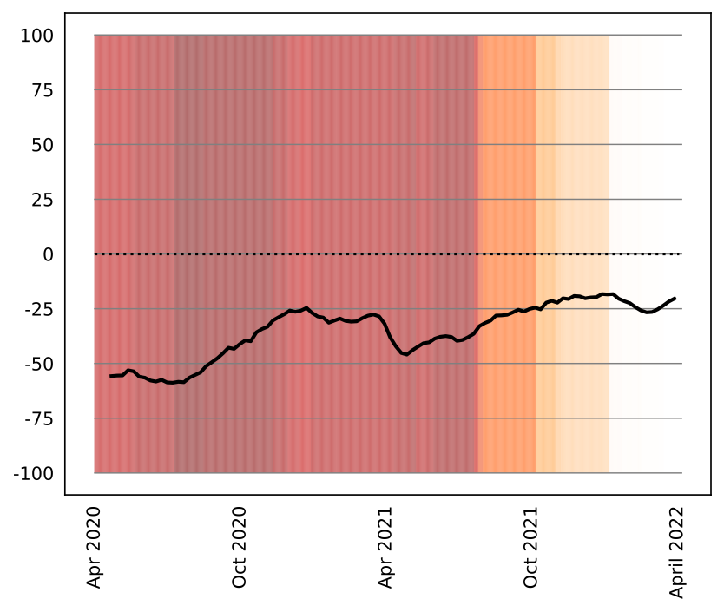
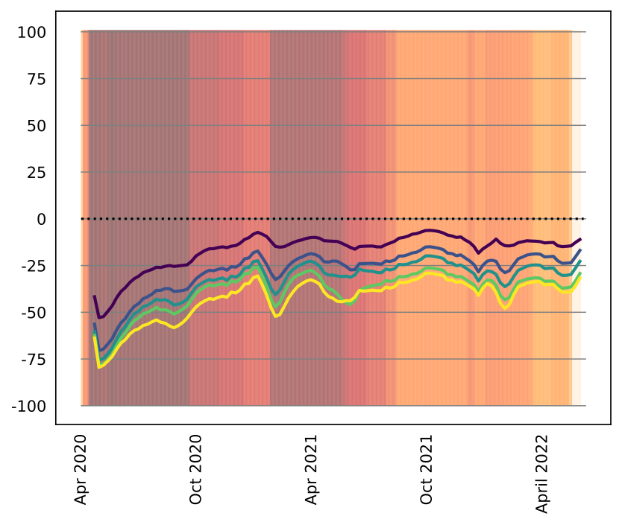
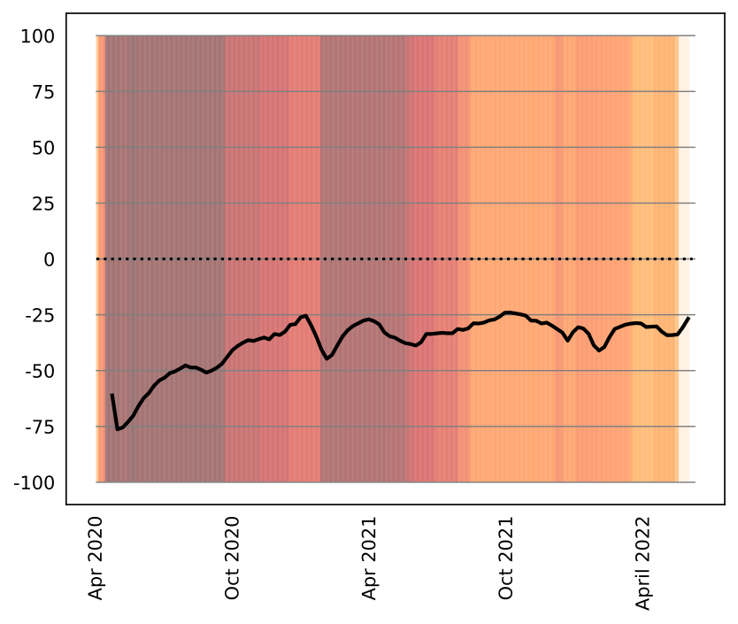
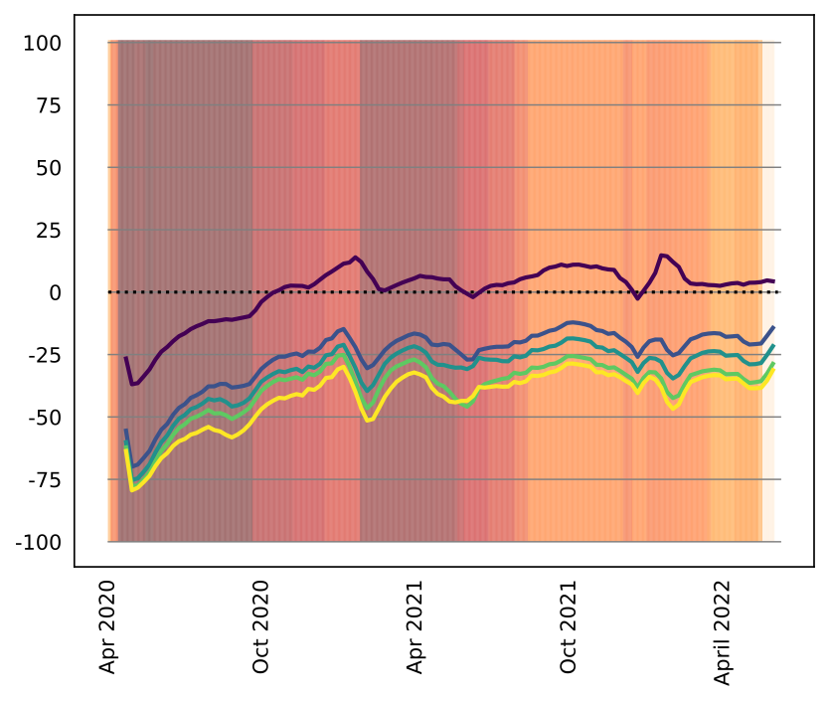

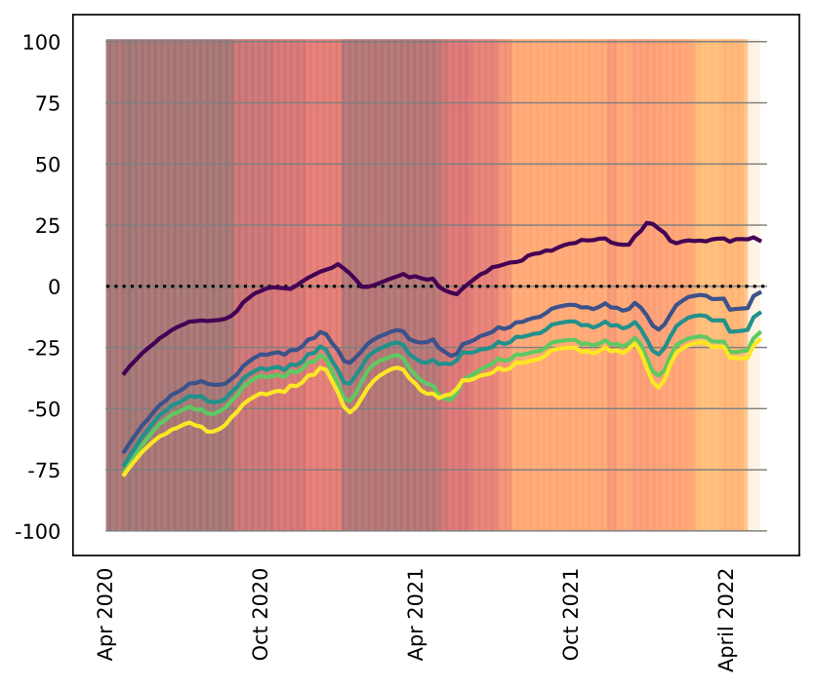

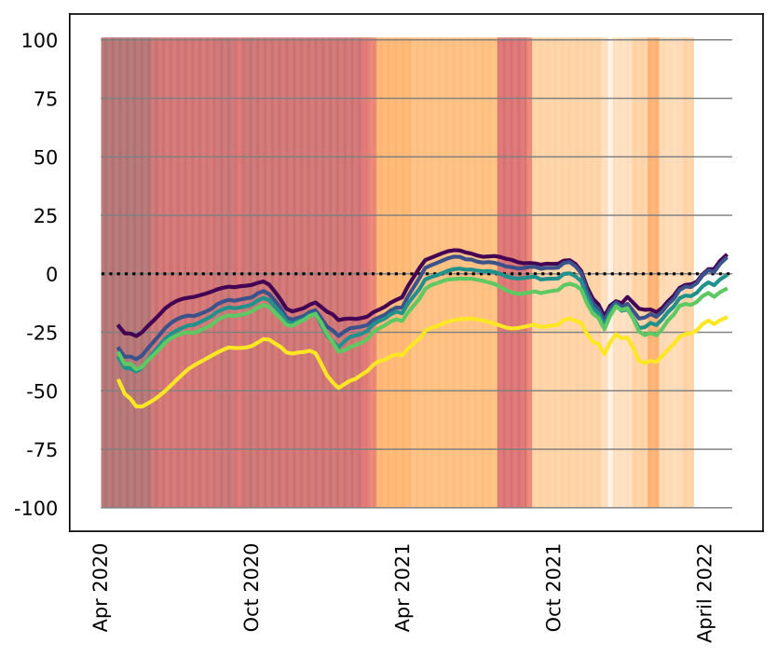
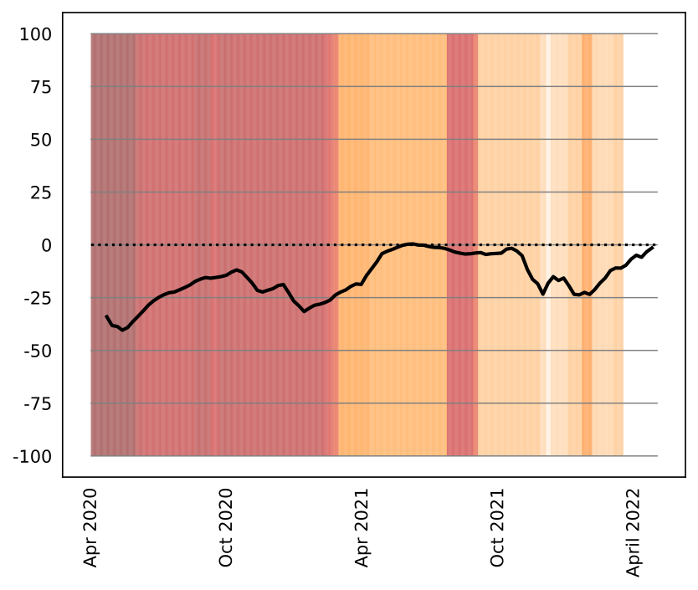
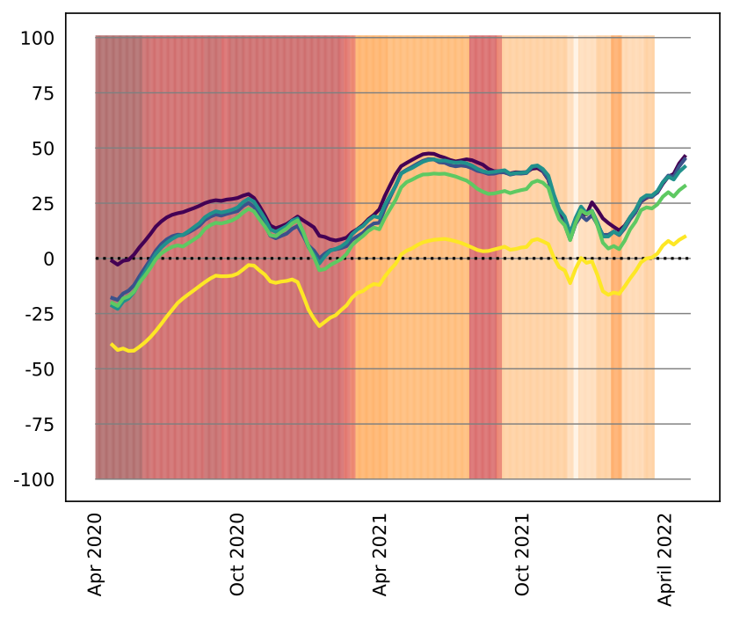
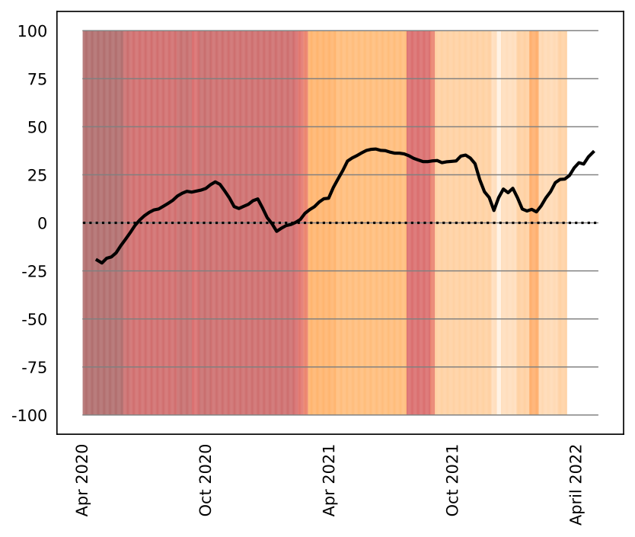


Outflows - by population density - new categories, new baseline
Raw
Total raw
Estimated
Total estimated
Adjusted
Total adjusted
Argentina
Chile
Colombia
Mexico

Slide 3
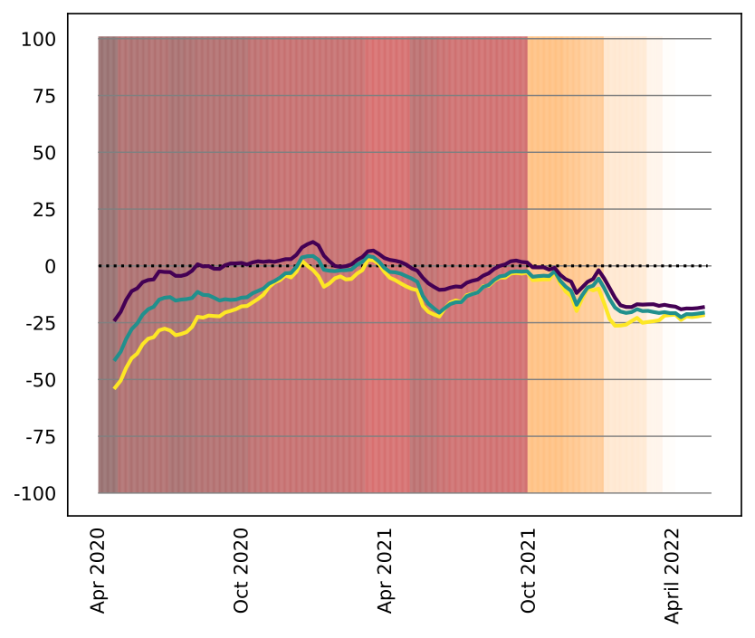
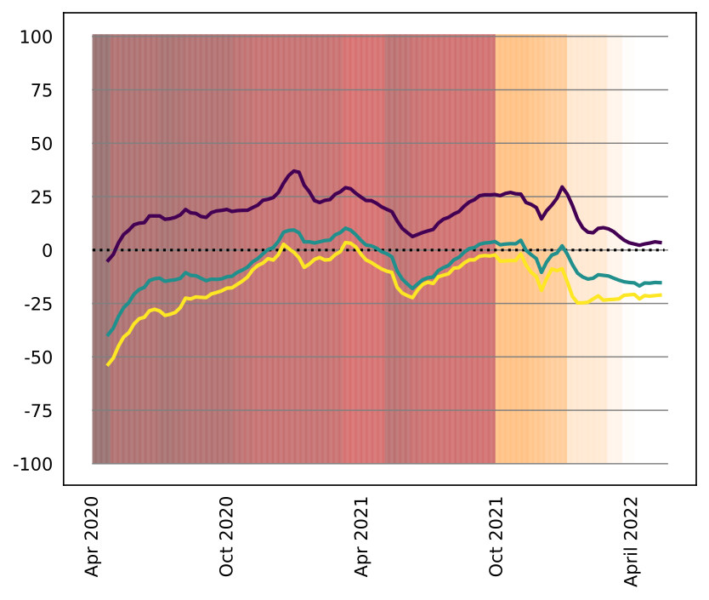
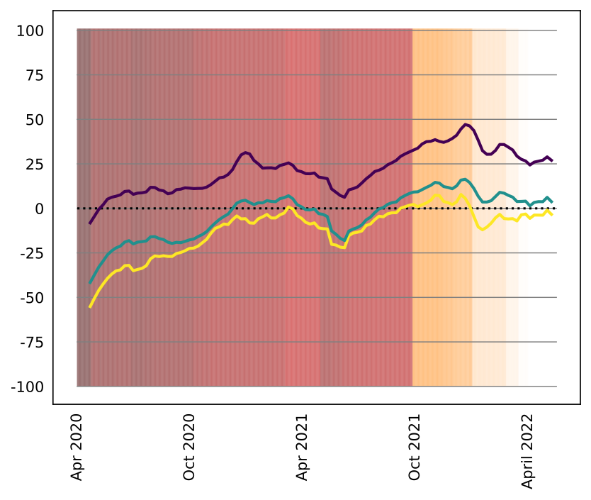
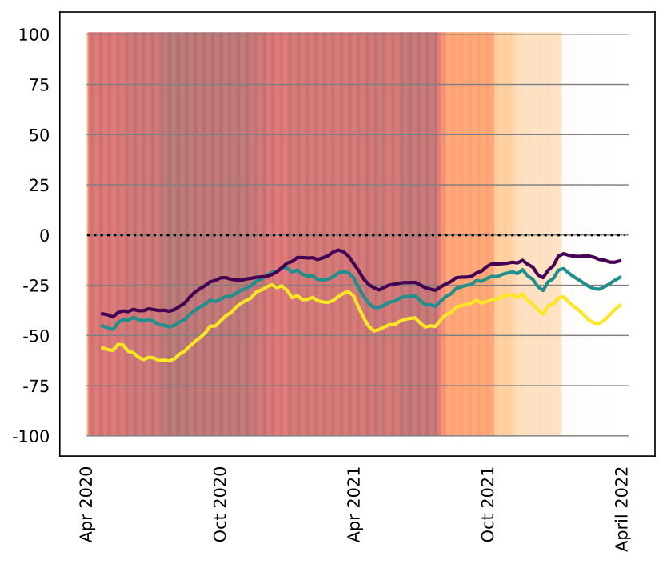
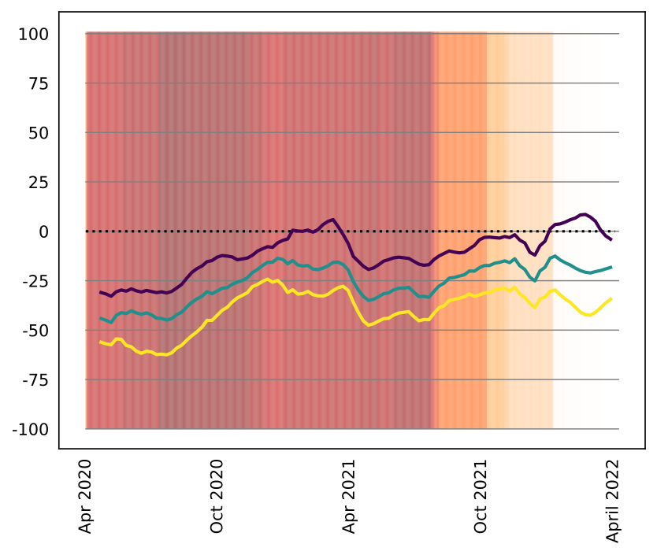
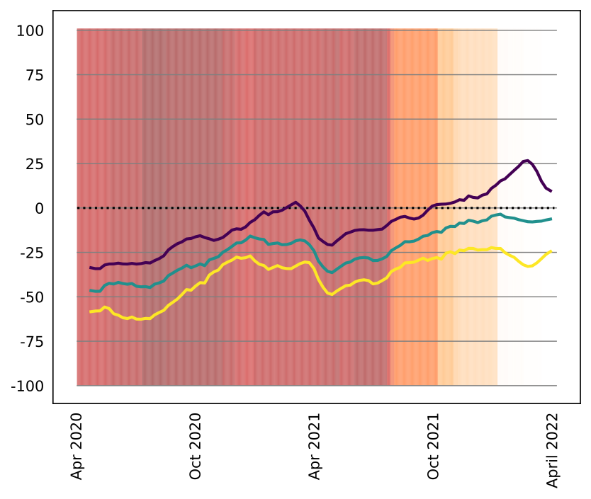



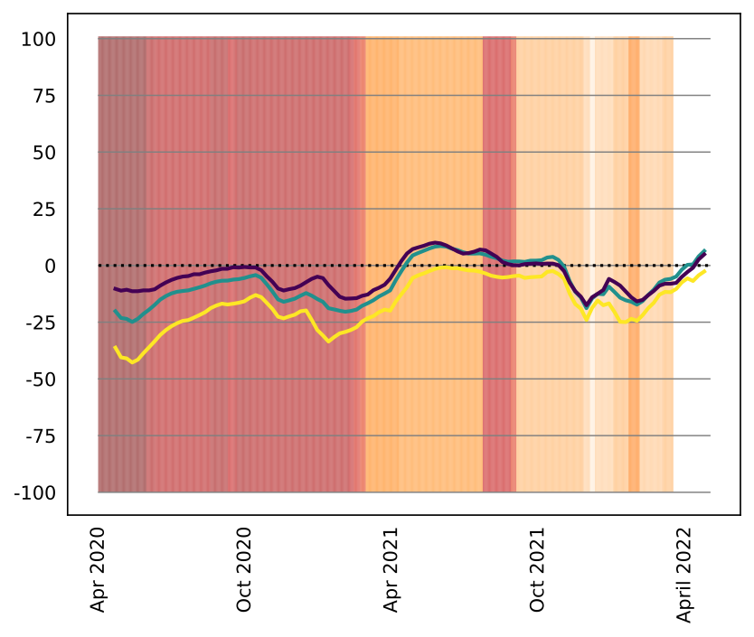

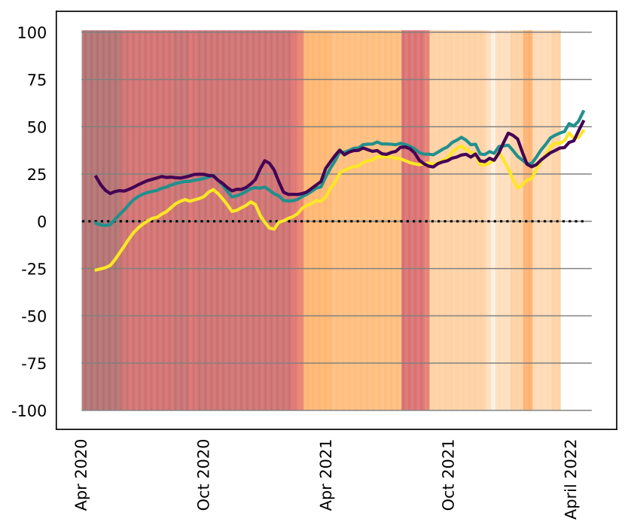
Outflows - by population rid - new categories, new baseline
Raw
Total raw
Estimated
Total estimated
Adjusted
Total adjusted
Argentina
Chile
Colombia
Mexico

Slide 4
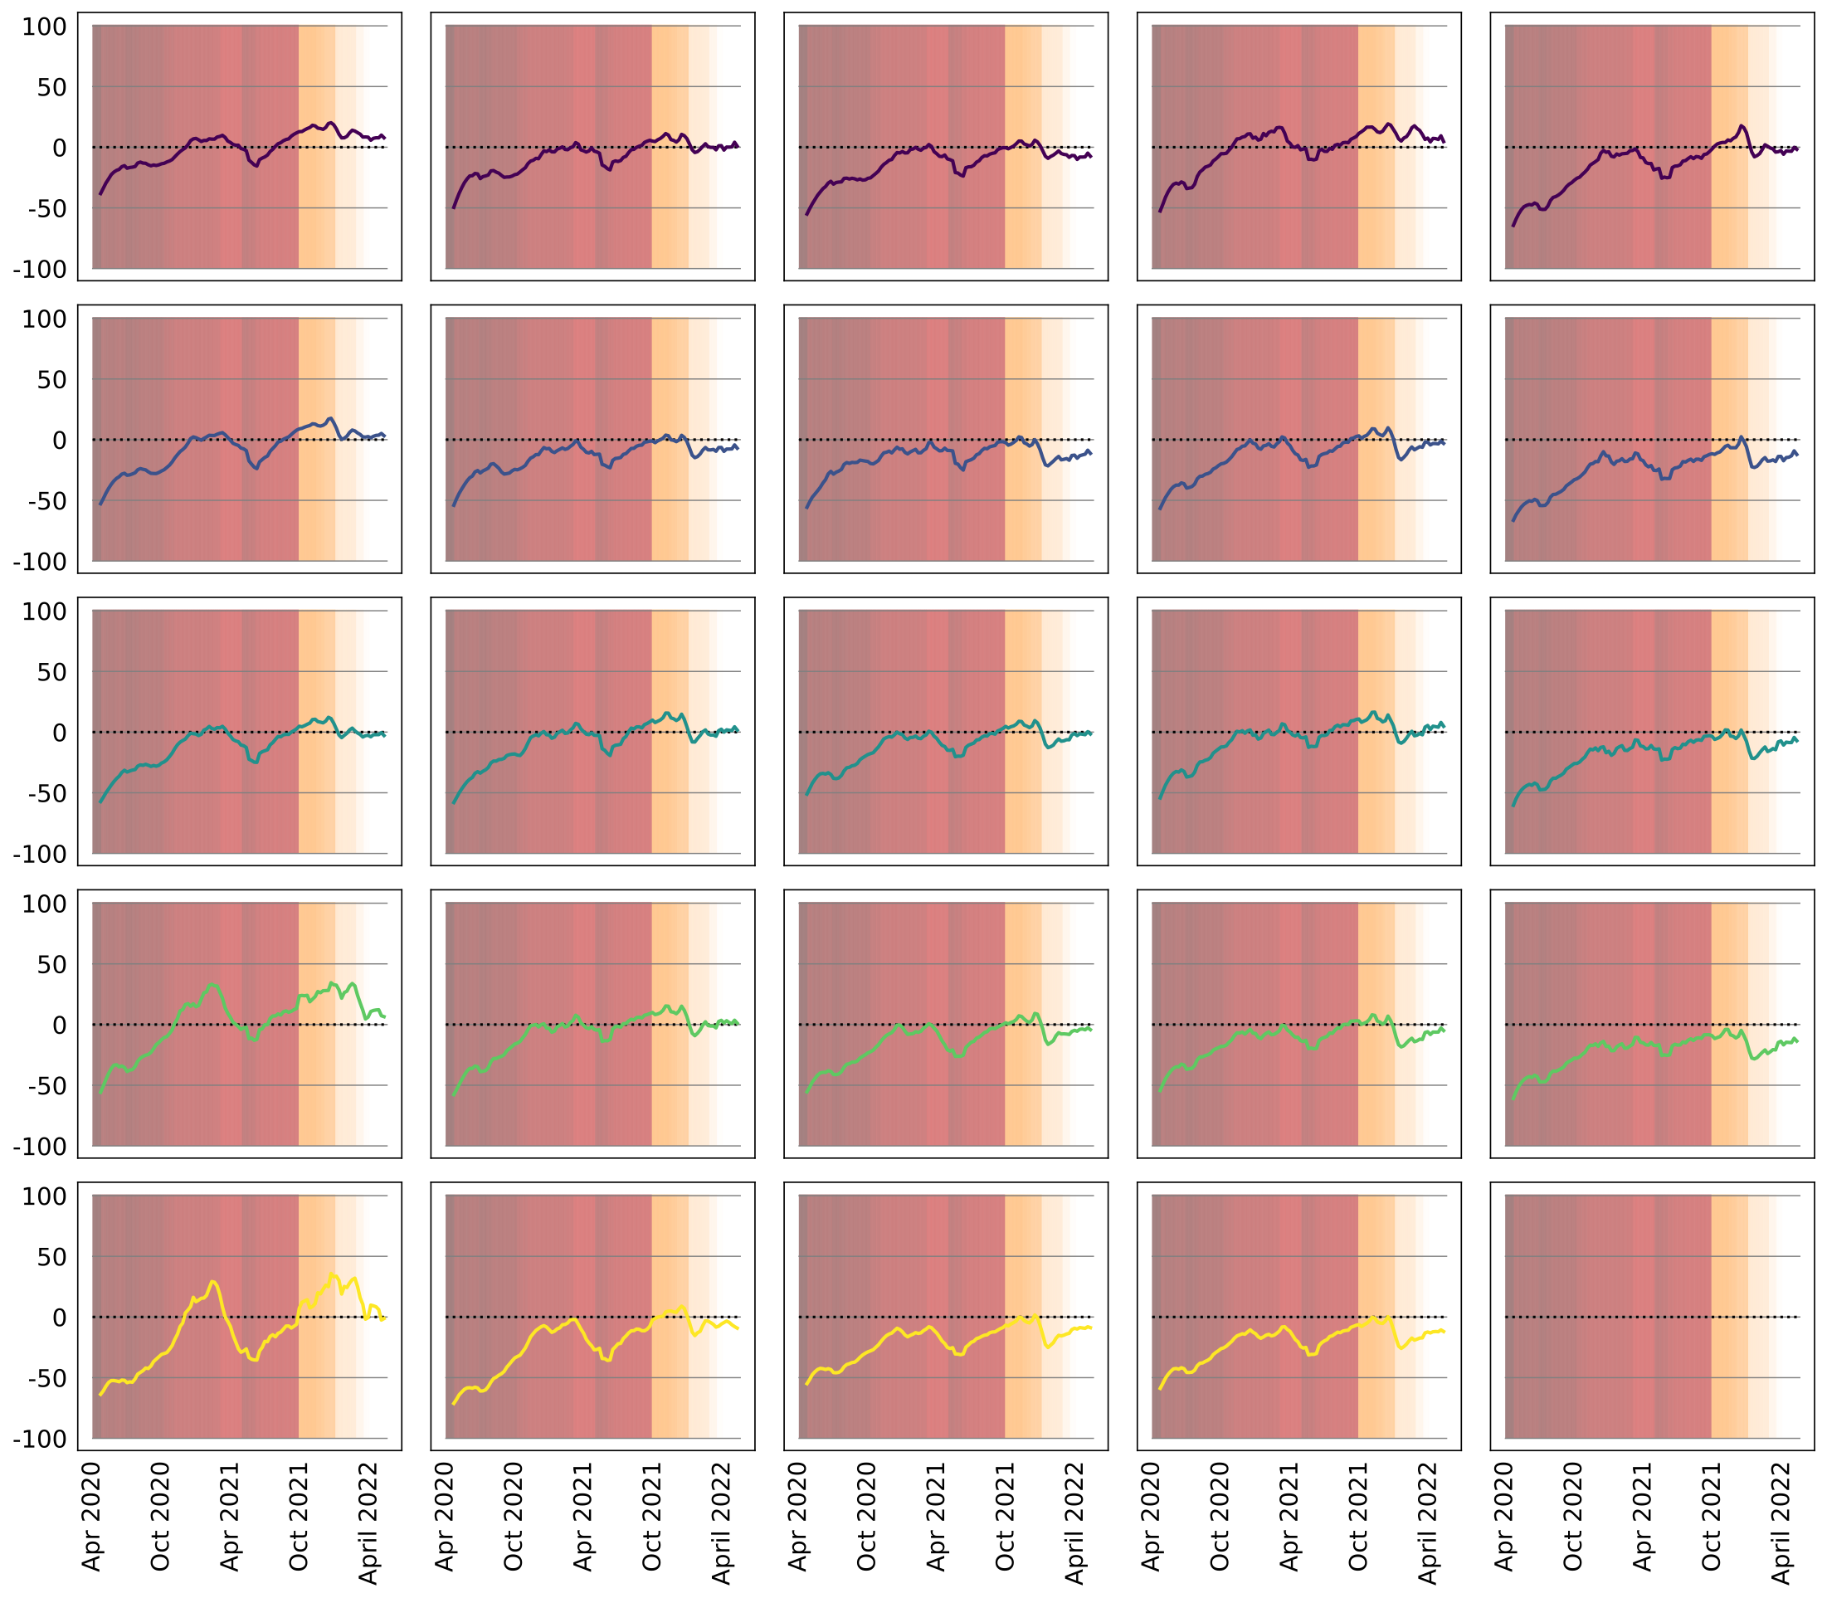
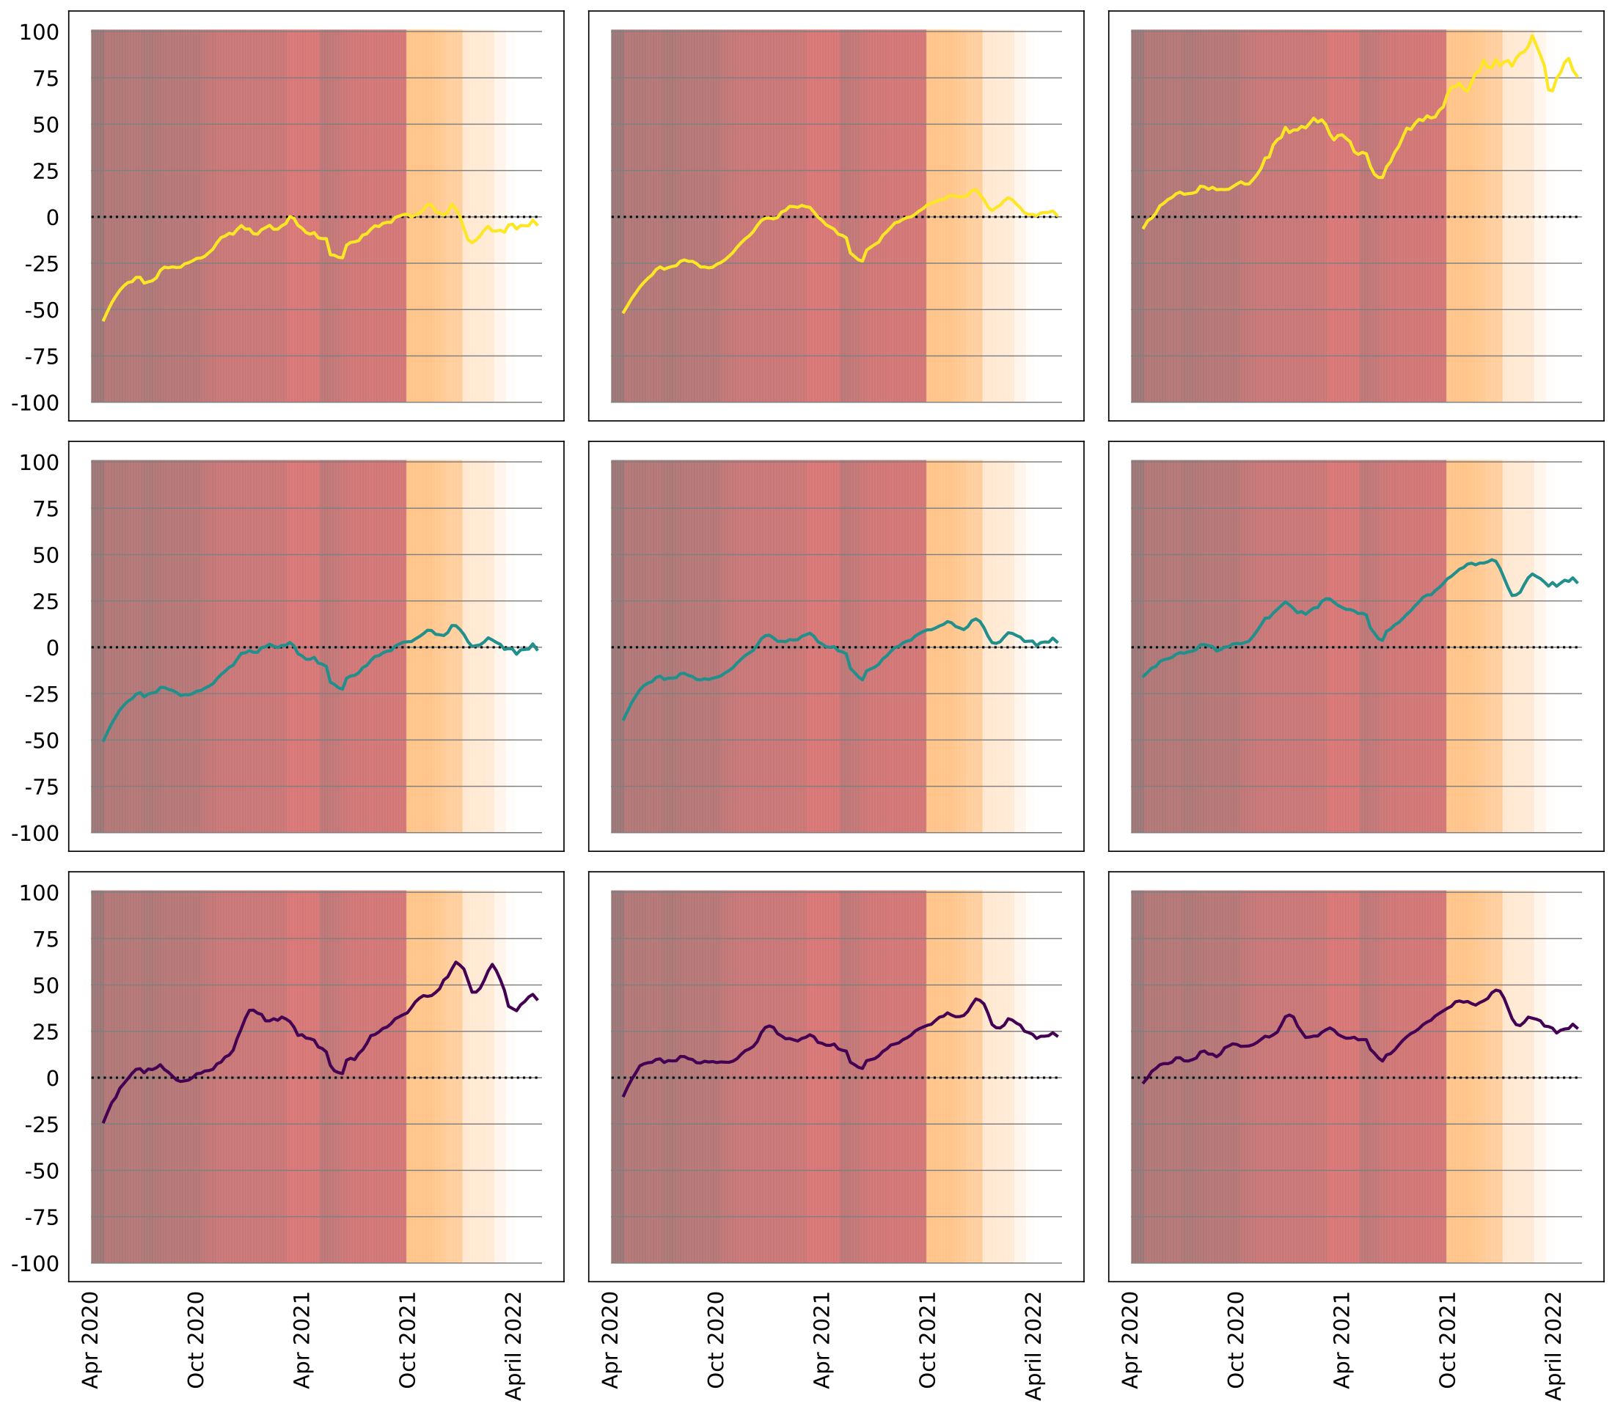
Movements between categories: density and RDI - Argentina (adjusted)
Lower density
Higher density
Lower density
Lower rdi
Higher rdi
Lower rdi
Higher density
Higher rdi

Slide 5
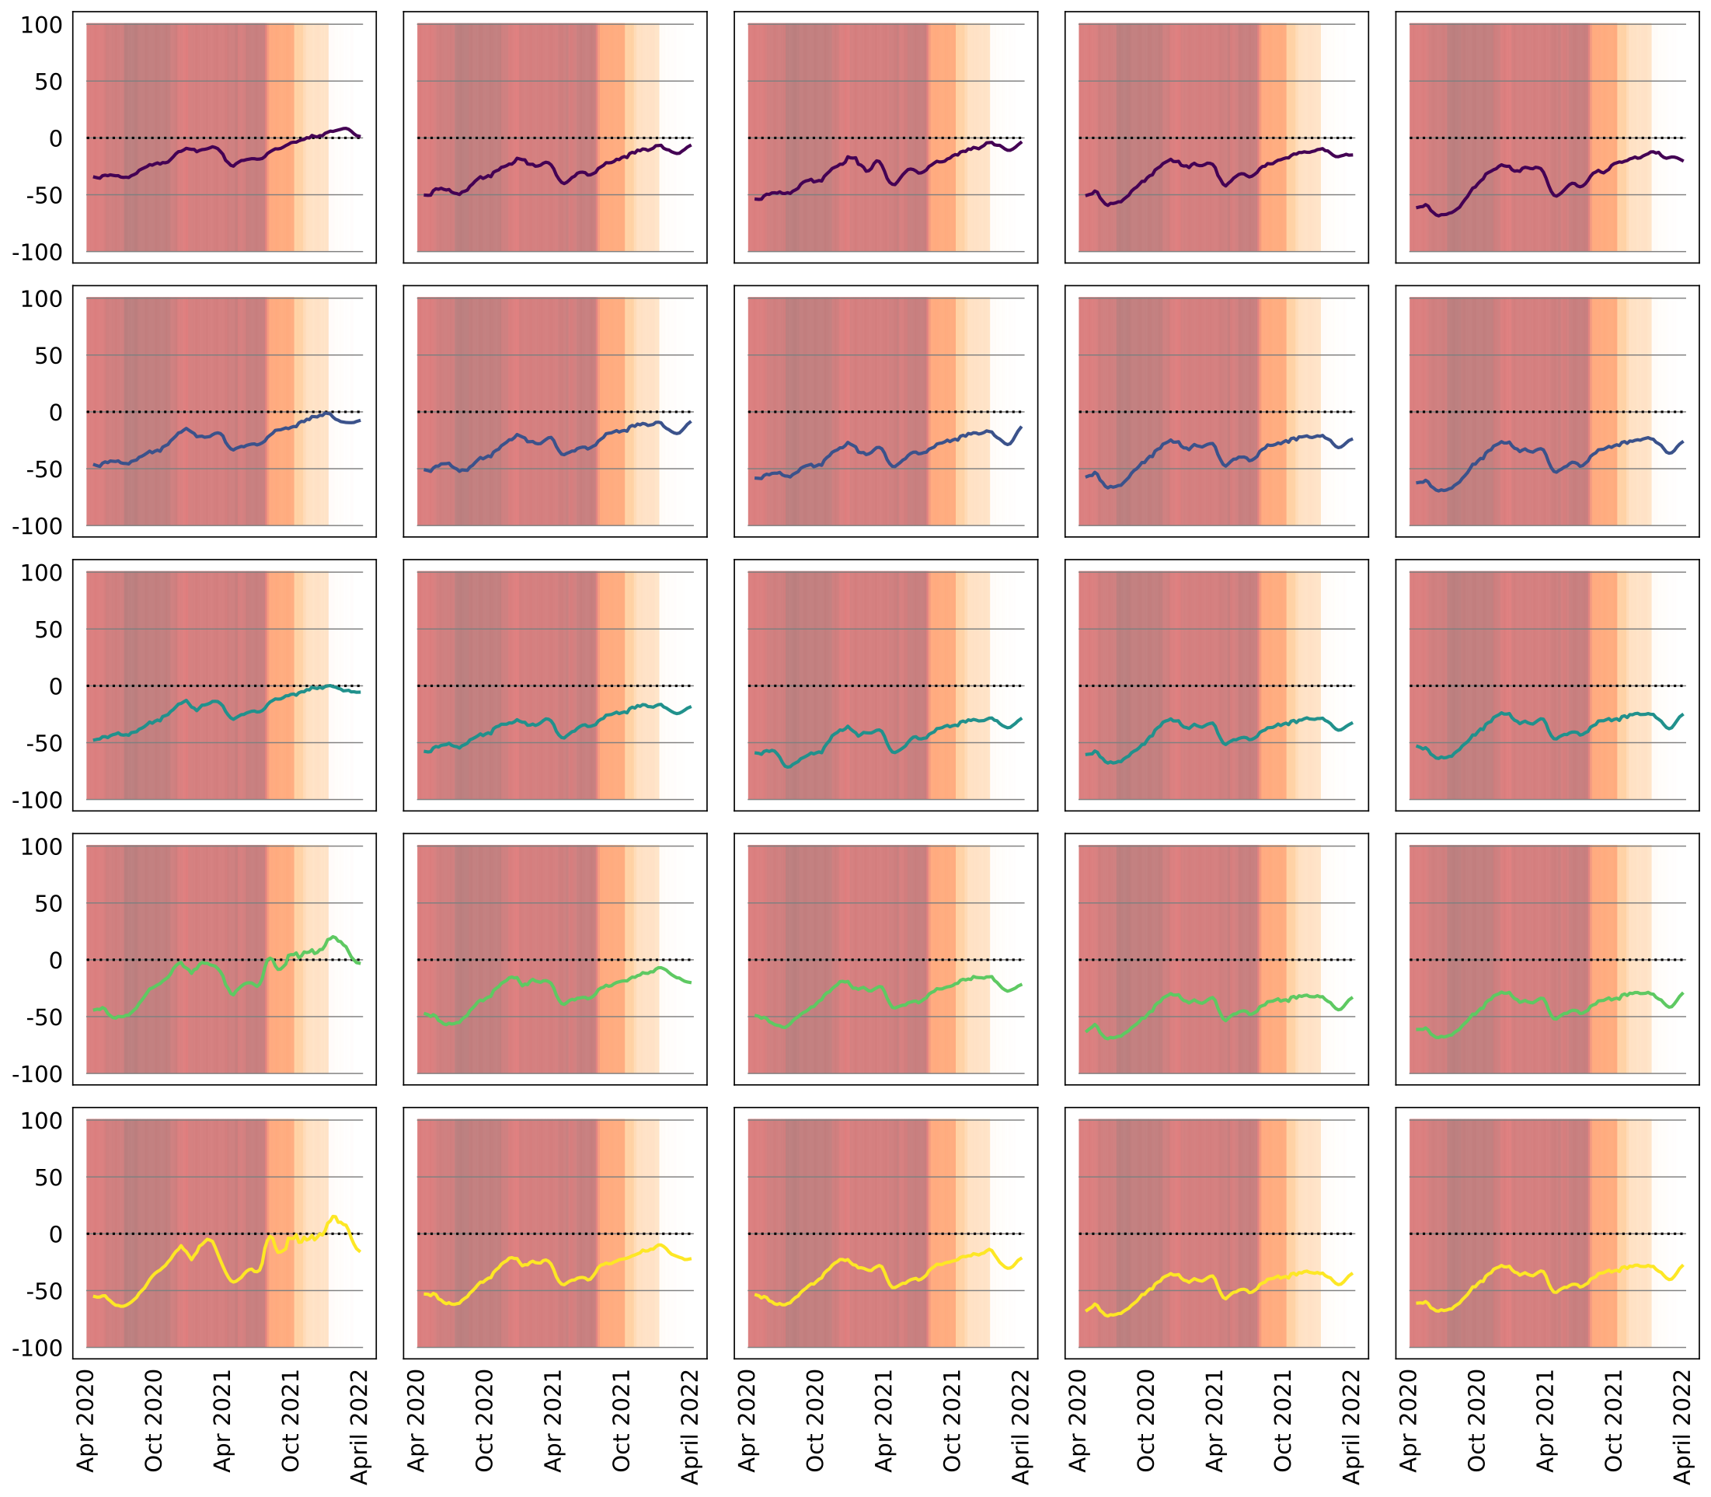
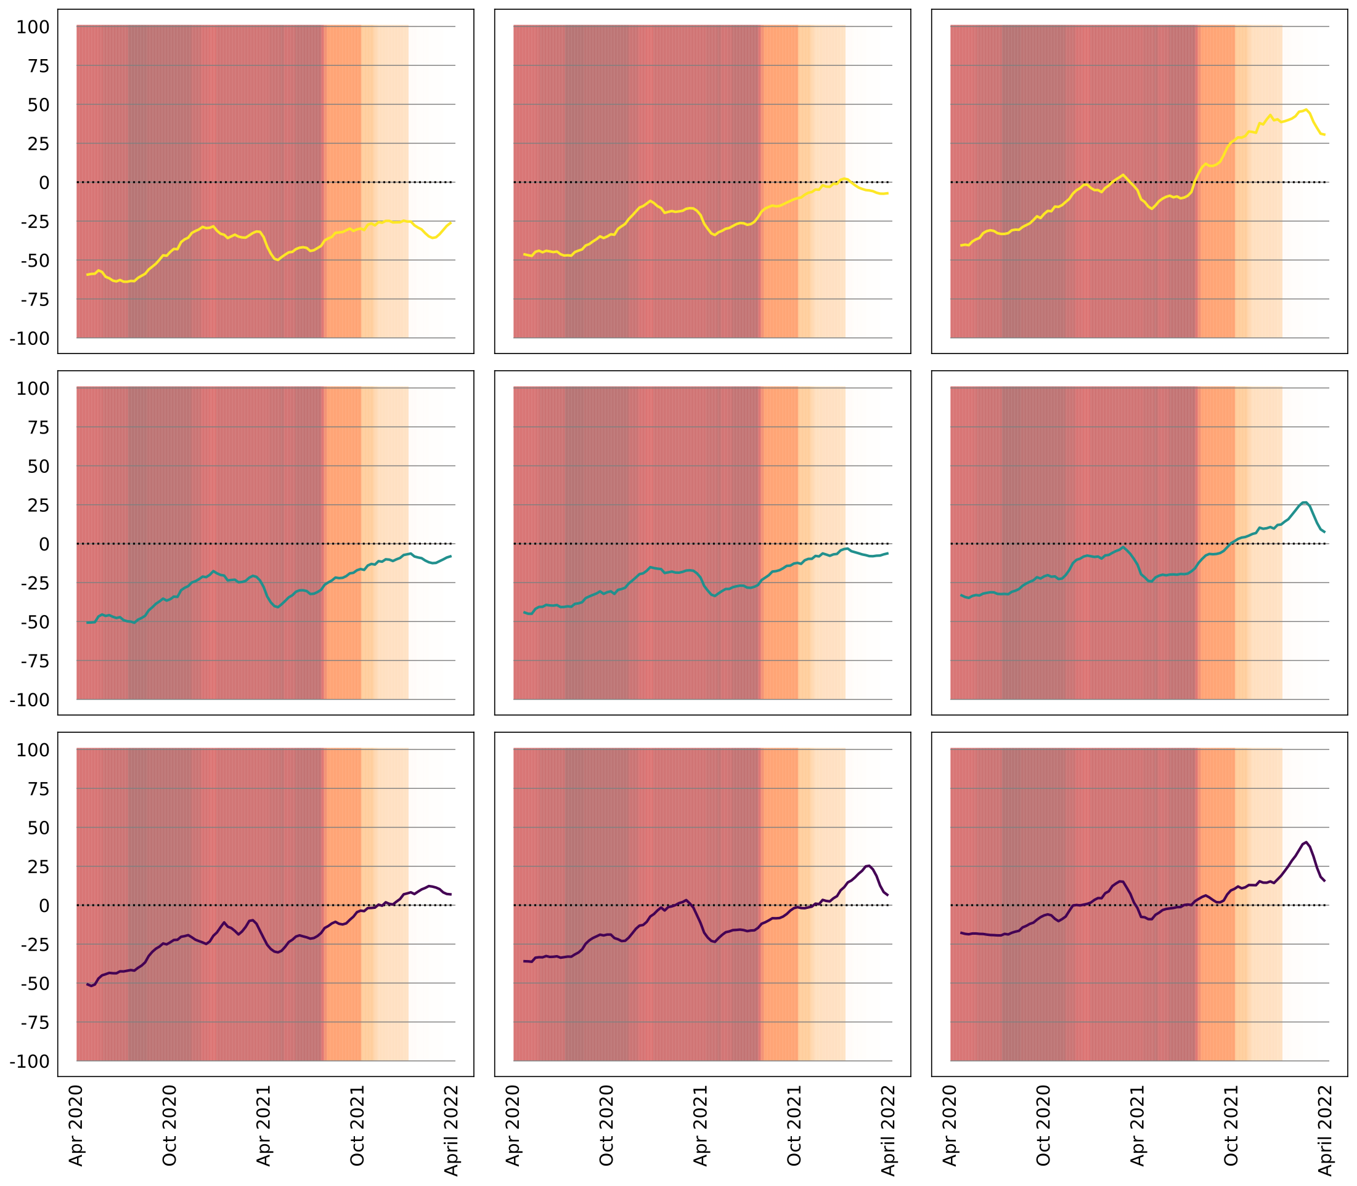
Movements between categories: density and RDI - Chile (adjusted)
Lower density
Higher density
Lower density
Lower rdi
Higher rdi
Lower rdi
Higher density
Higher rdi

Slide 6
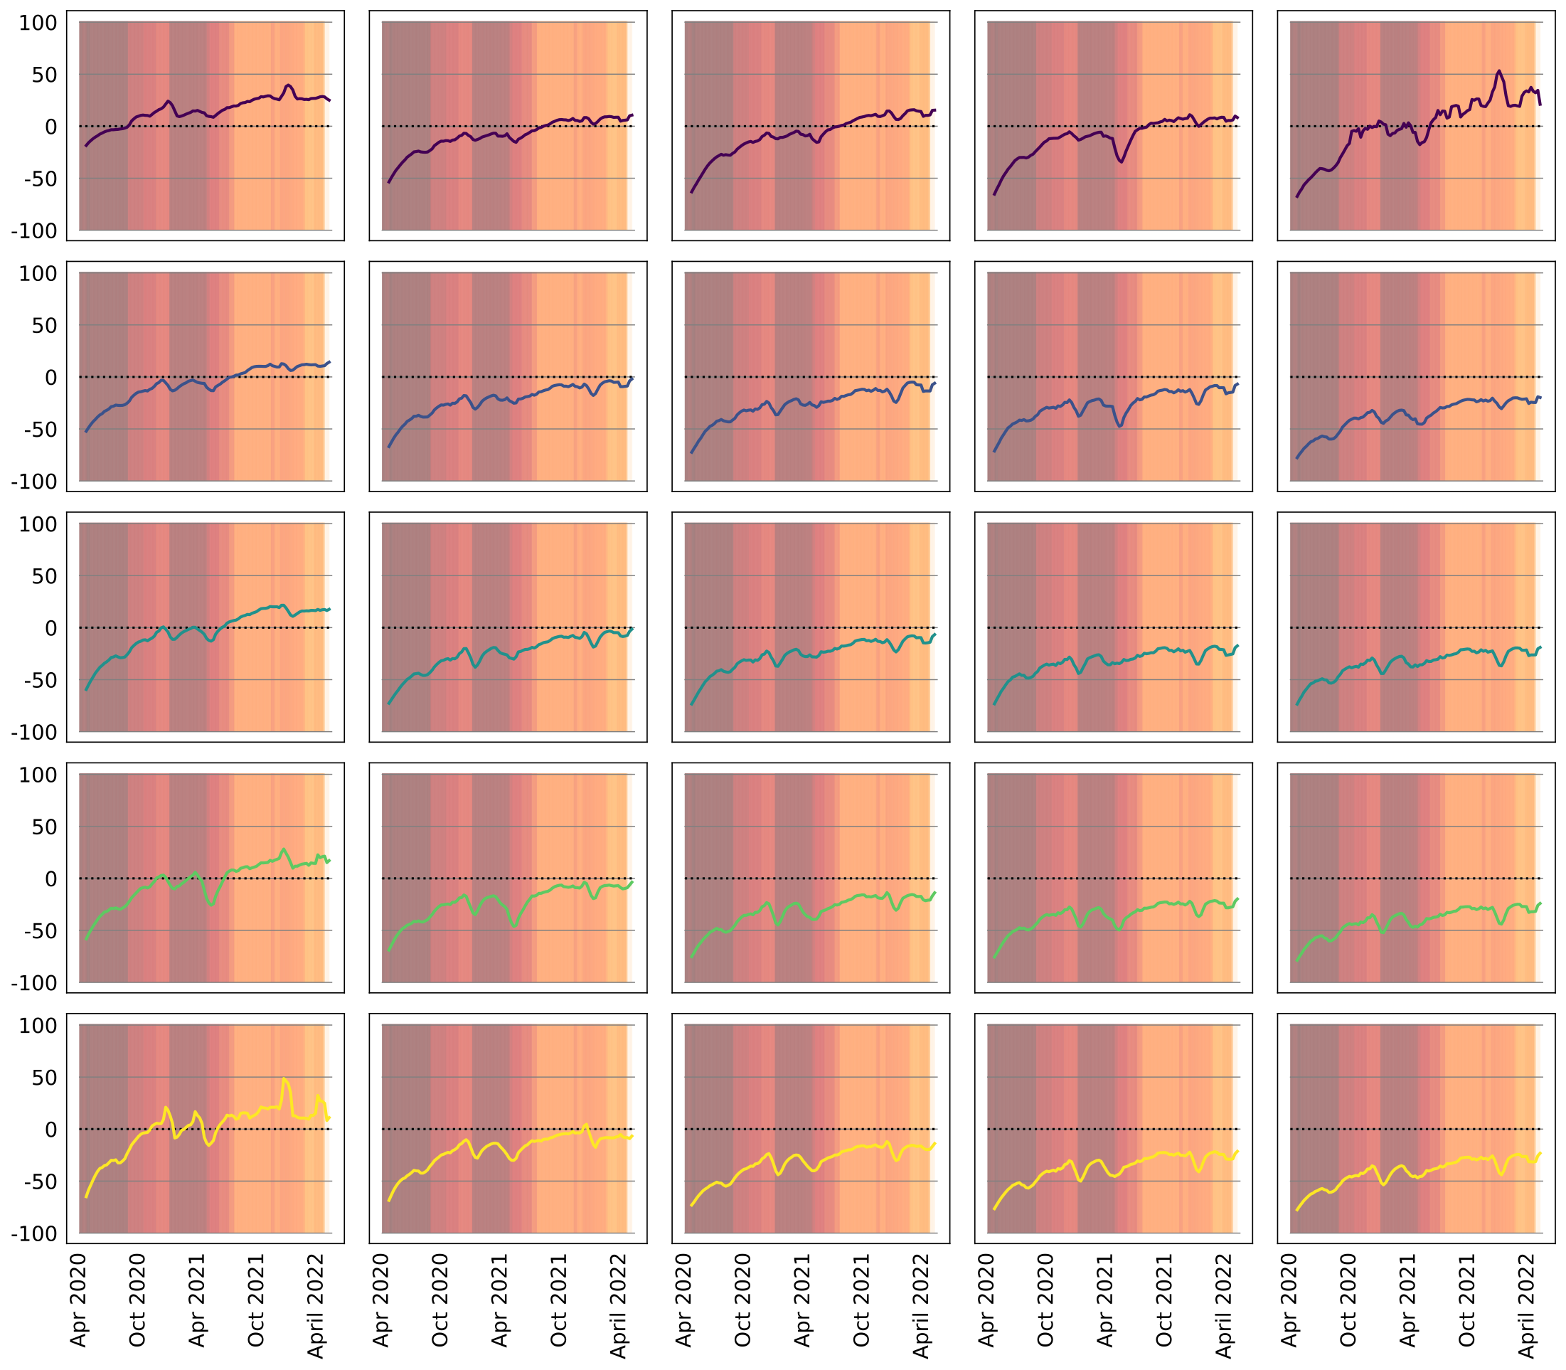
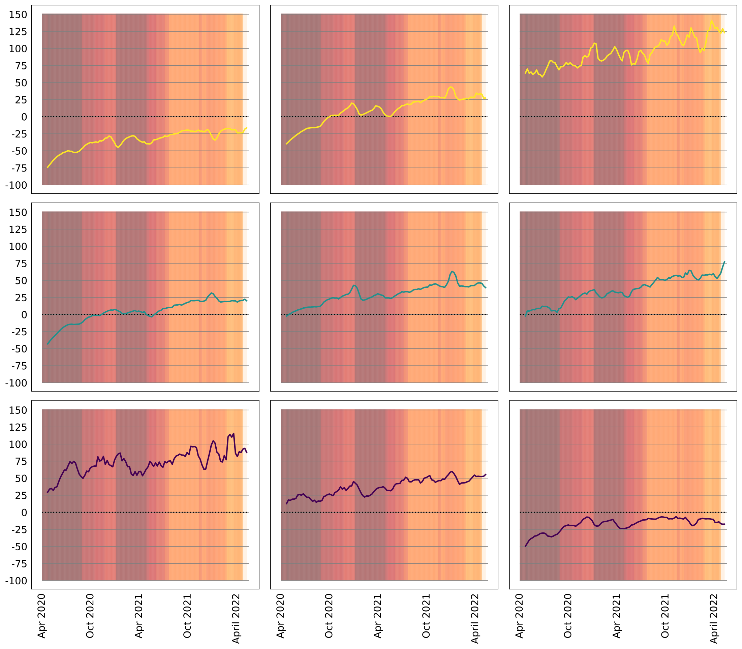
Movements between categories: density and RDI - Colombia (adjusted)
Lower density
Higher density
Lower density
Lower rdi
Higher rdi
Lower rdi
Higher density
Higher rdi

Slide 7
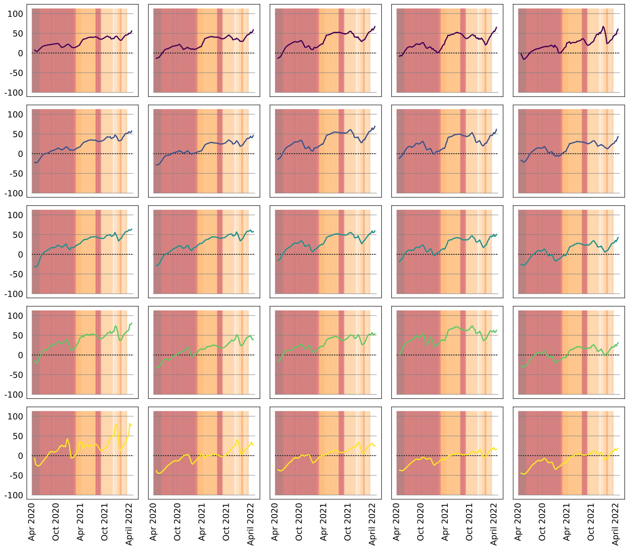
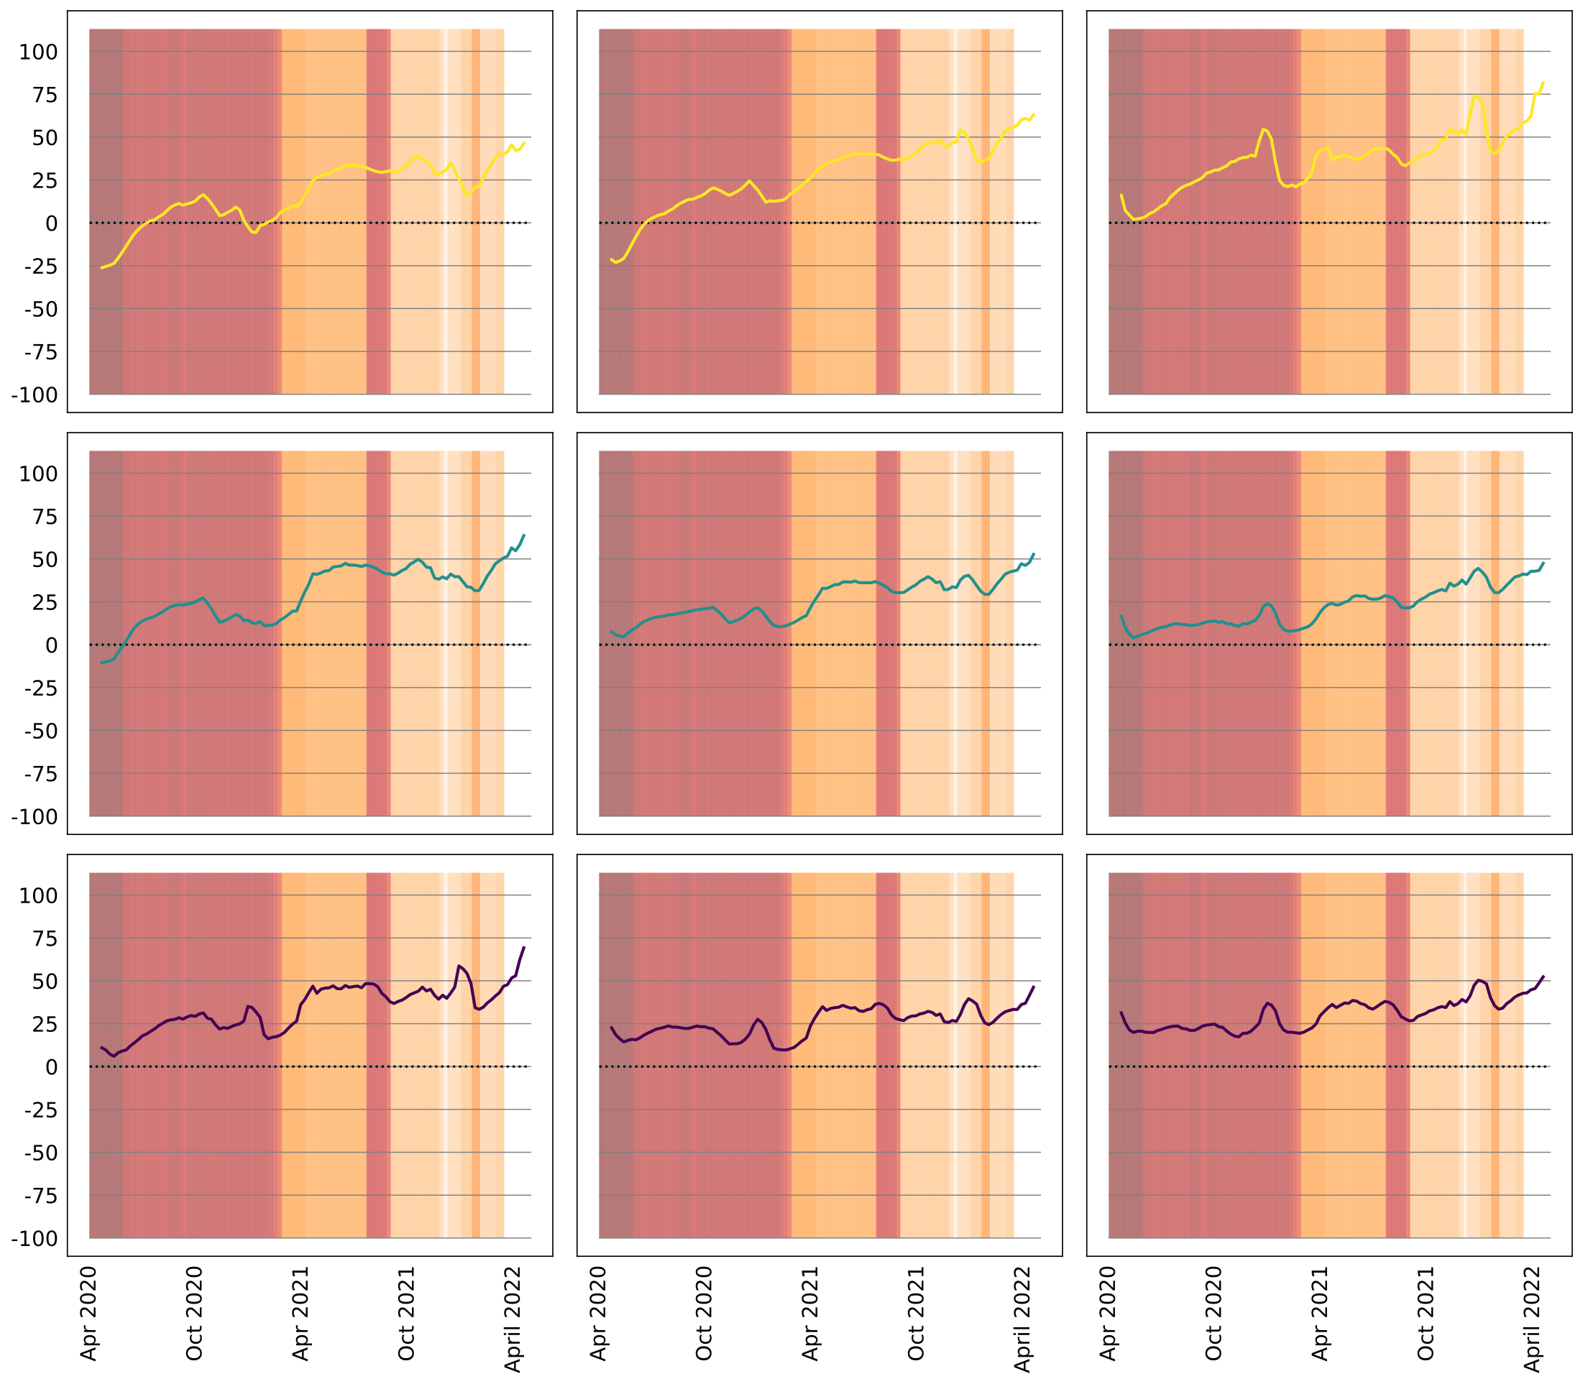
Movements between categories: density and RDI - Mexico (adjusted)
Lower density
Higher density
Lower density
Lower rdi
Higher rdi
Lower rdi
Higher density
Higher rdi

